Slide 1
How to look for your assignments, quizzes or tests
By: Erika Spencer

Slide 2
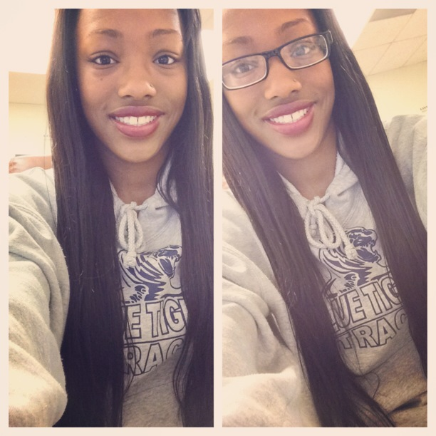
About me
Name: Erika Spencer
Email: erika.spencer899@my.lincolnu.edu
Occupation: Student Canvas Trainer for the 2014-2015 year
Extracurricular activities: I’m a part of the Lincoln women’s track team. This past year we have won Nationals!

Slide 3
This is the screen you should start off with

Slide 4
Click “courses” at the top left side of the screen .

Slide 5
Click “modules” on the left side to access your assignments, quizzes, tests or anything your teacher has put in the course.

Slide 6
Now you can see anything you teacher expects you to learn, know or complete throughout the semester.

Slide 7
*Reminder
You may not have the same class as me but the concept is the same.

