Slide 1
How To Record A Discussion Video on Canvas
By Nnanna Ihenacho

Slide 2
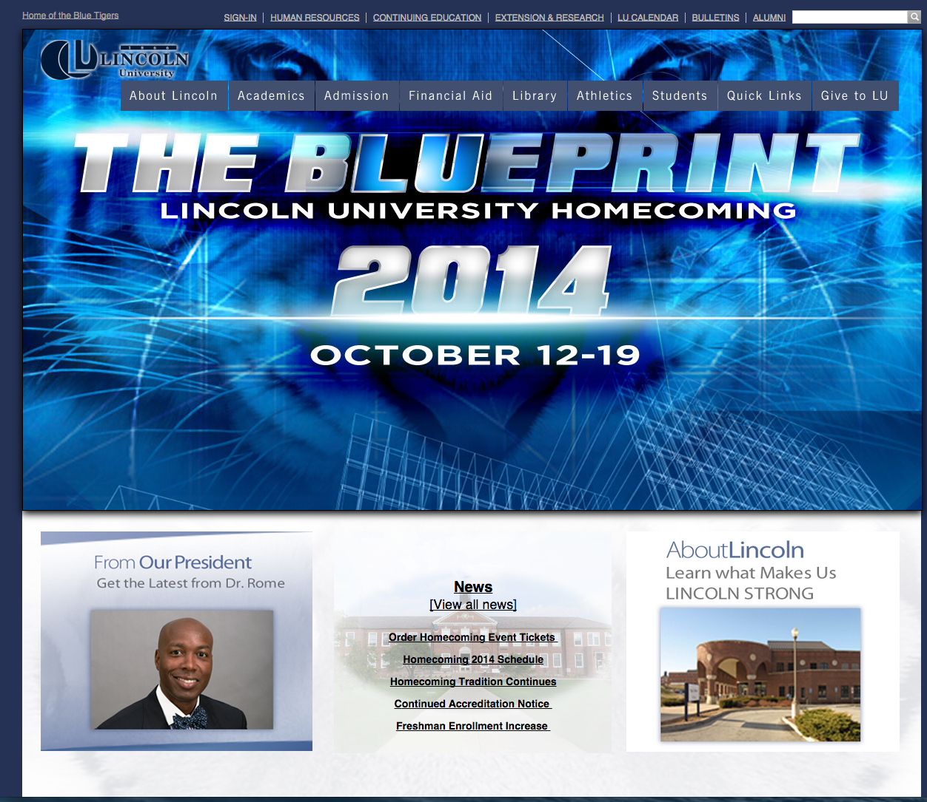
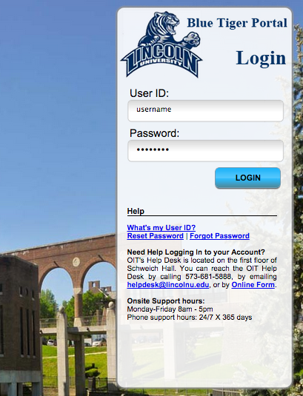
Notes:
Go to the Lincoln homepage and sign into your username

Slide 3
Notes:
Click on the LU Online link to open Canvas

Slide 4
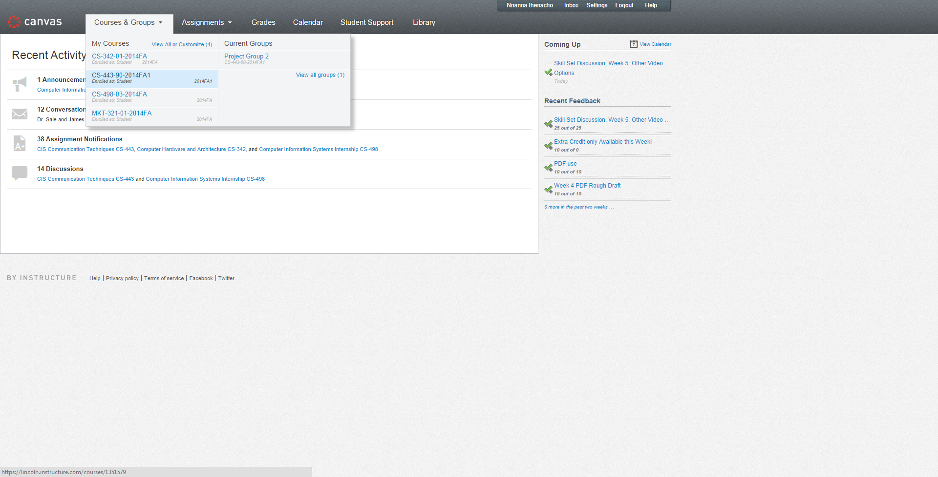
Notes:
Click on a course and click on either the modules link or the enter the course link.

Slide 5
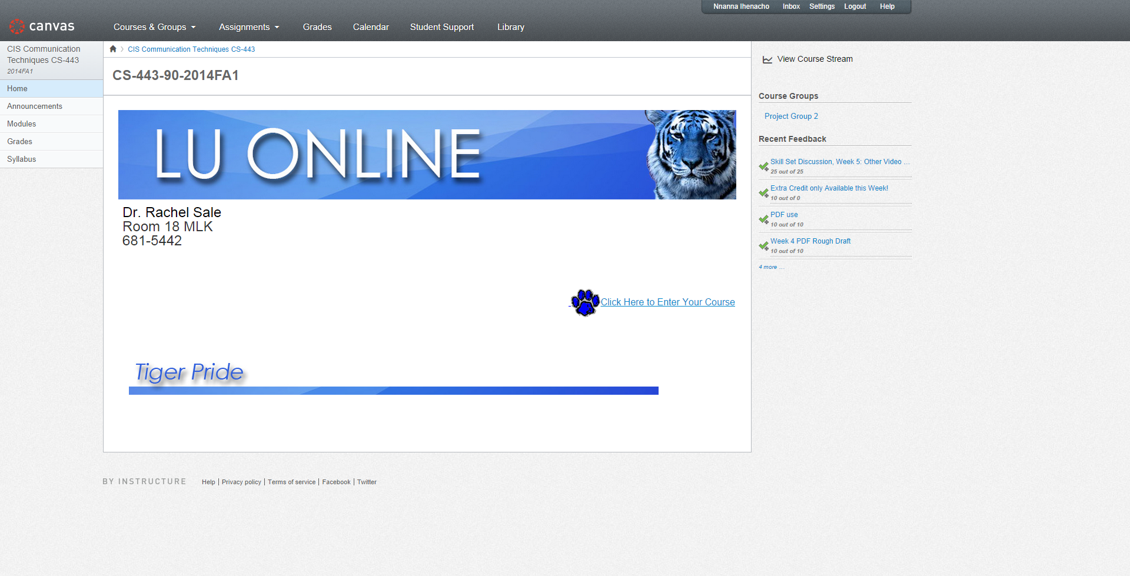
Notes:
Click on the modules link or the enter the course link to access the work modules

Slide 6
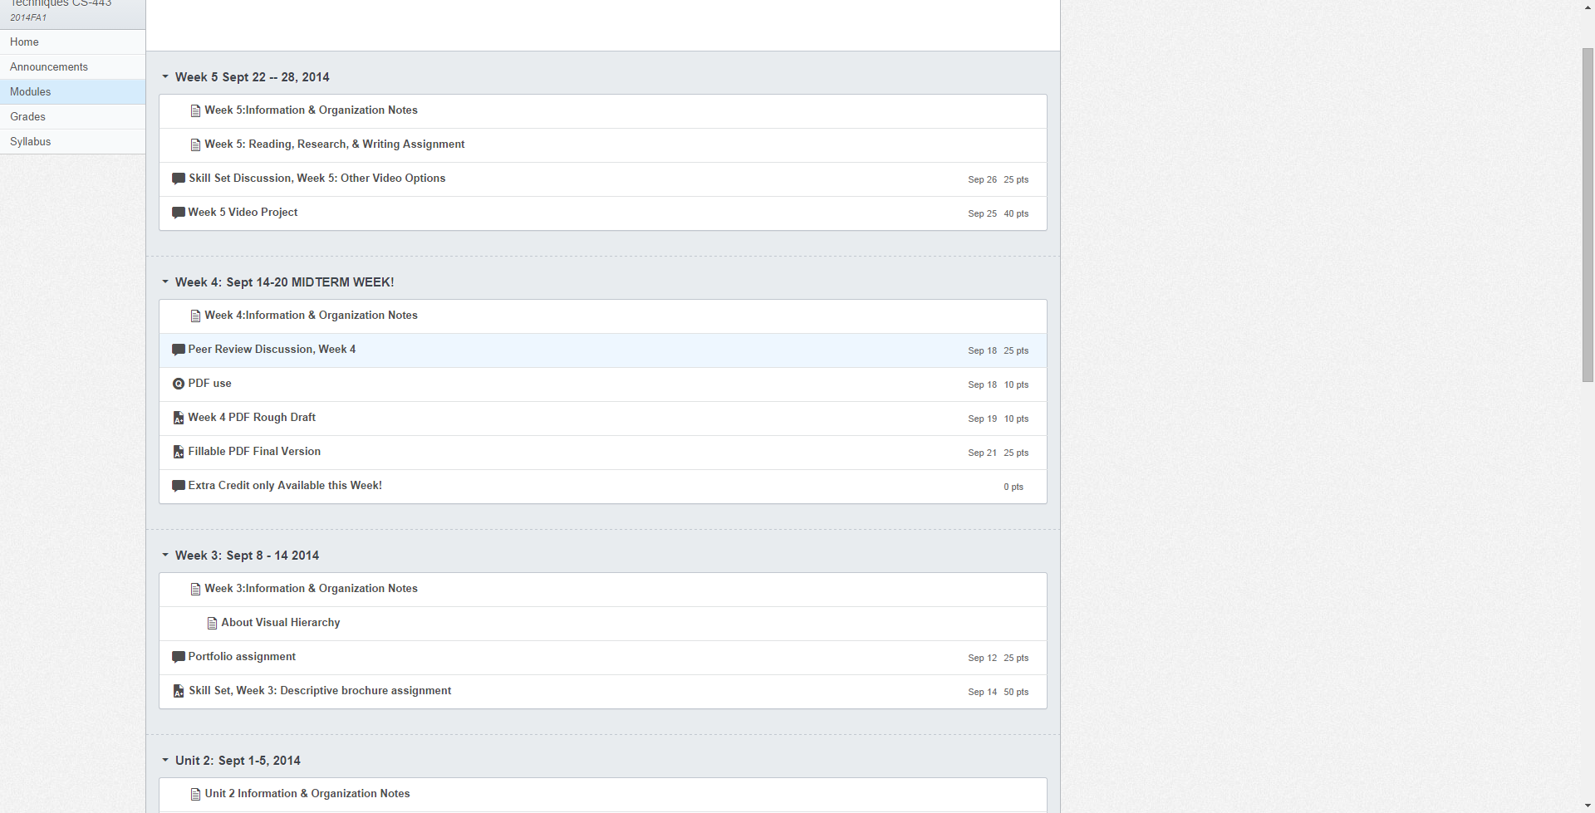
Notes:
Click on a discussion link.

Slide 7
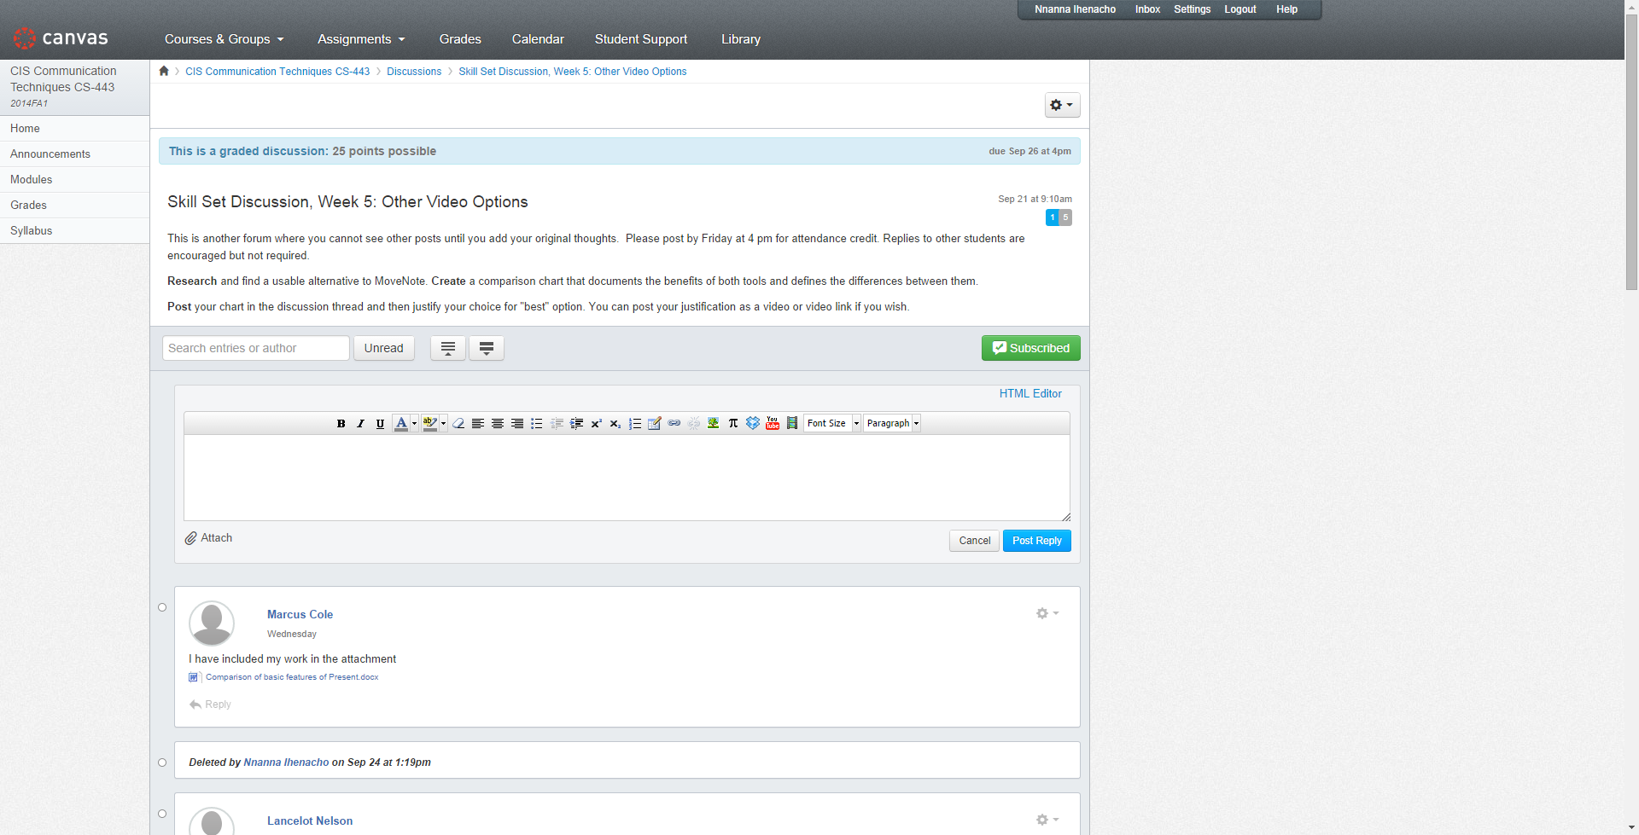
Notes:
Click inside the reply box, then click on the record/upload video link

Slide 8
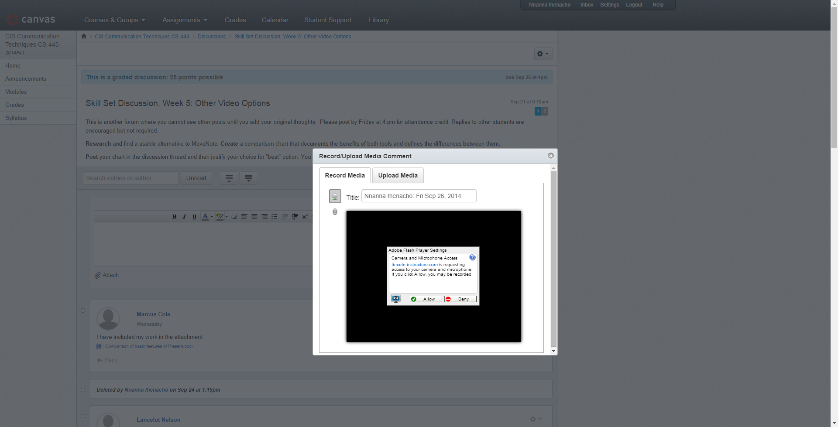
Notes:
Click allow on the warning message to display the webcam

Slide 9
Notes:
Click to start the video

Slide 10
Notes:
When you are done recording, click again to stop the video and save it

Slide 11
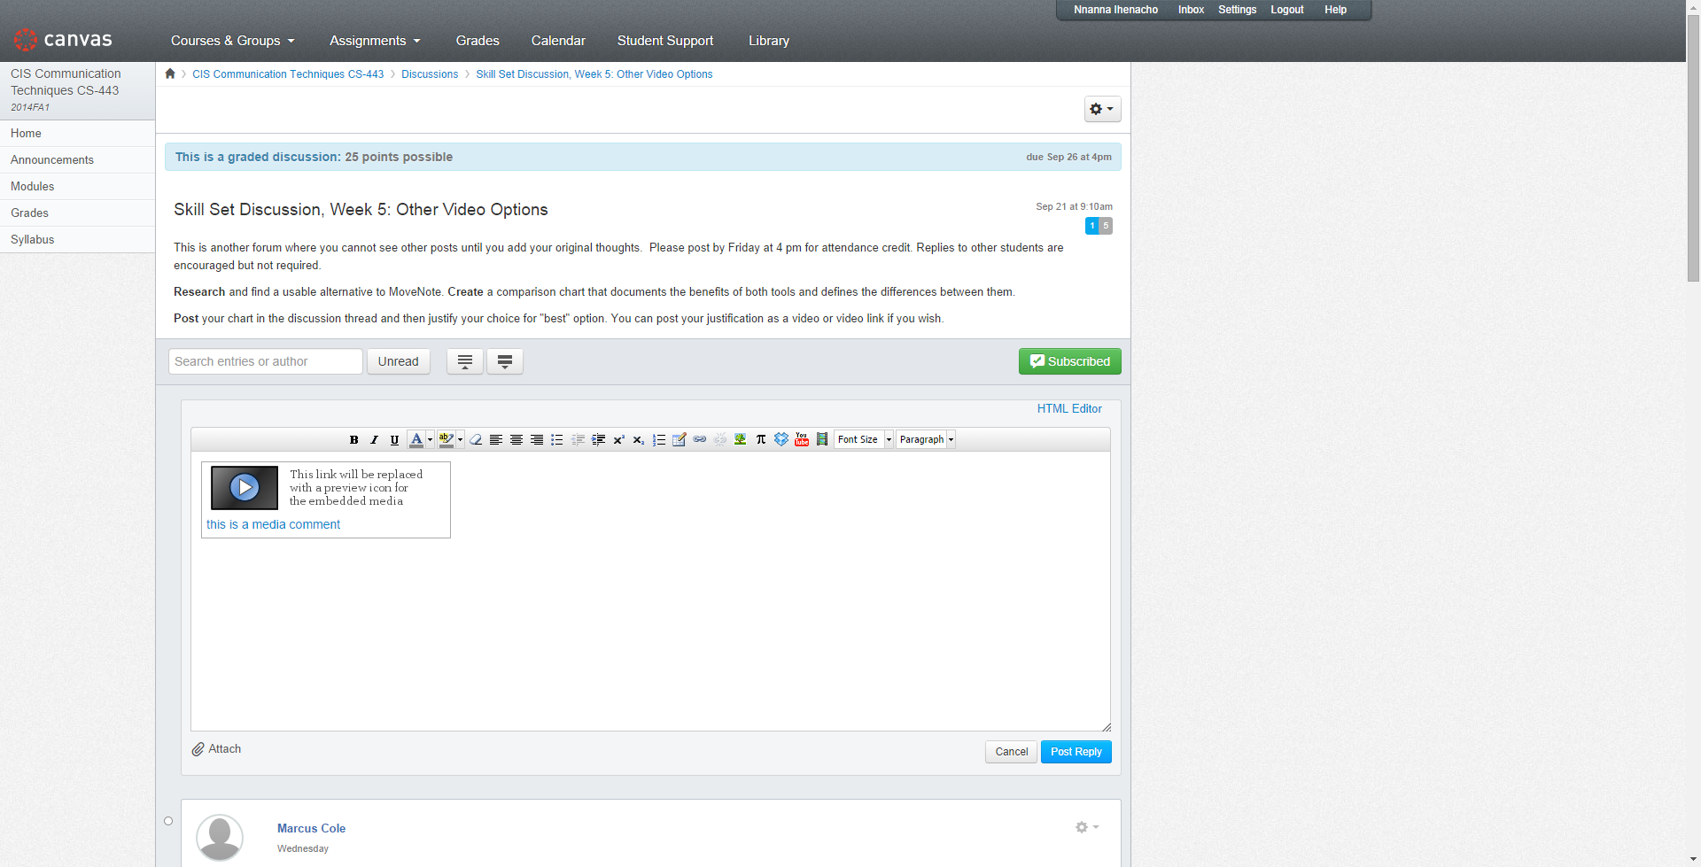
Notes:
Click on Post Reply to post your video.

Slide 12
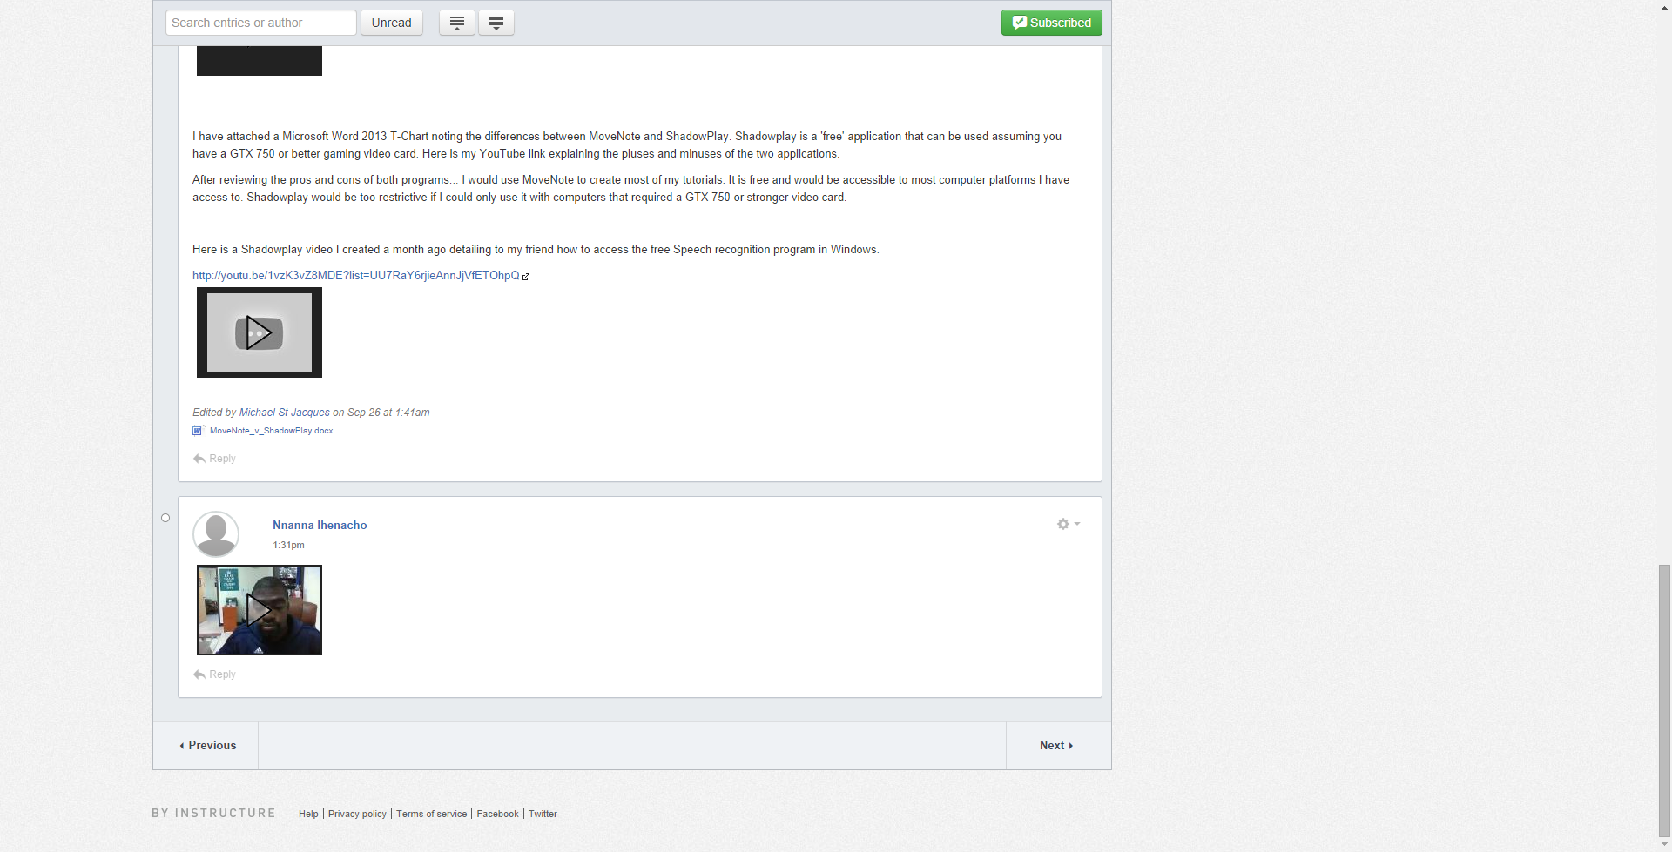
Notes:
Your video discussion is completed.

