Slide 1
Women in America
Lecture 10
World War II

Slide 2
World War II
The Japanese bombing of Pearl Harbor brought the United States into World War II.
In 1941, the U.S. was in an interesting situation. For more than a decade American women had been lectured on their responsibilities as wives and mothers and advised to avoid employment unless absolutely necessary.
Now the government had to recast women as potential workers.
In areas of the country experiencing labor shortages, the WMC used propaganda films, posters, billboards and radio personalities.
Initially, the War Advertising Council, an agency of the WMC and OWI emphasized the good wages women could earn.
Next came the character of “Rosie the Riveter.” She appeared newspapers, magazines, and advertisements.

Slide 3
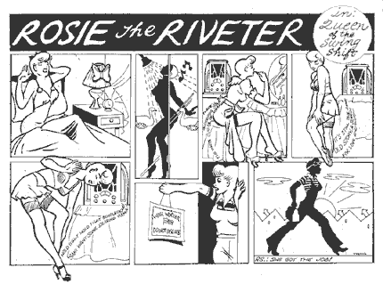
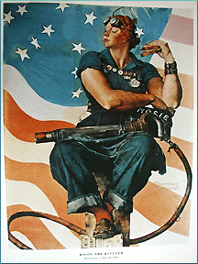
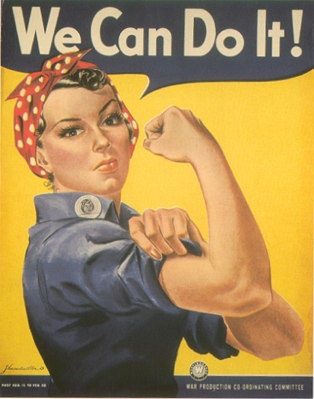

Slide 4
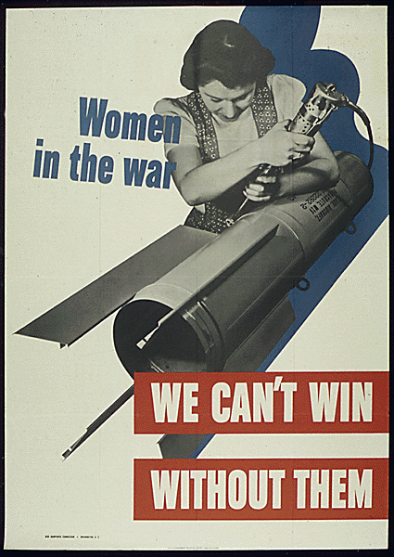
World War II
Rosie called housewives to join the army of the employed.
Rosie caught the public imagination. Movies emphasized women’s working; ads promoted women working; songs promoted women’s work effort – “Rosie the Riveter” and “We’re the Janes Who Made the Planes.”

Slide 5
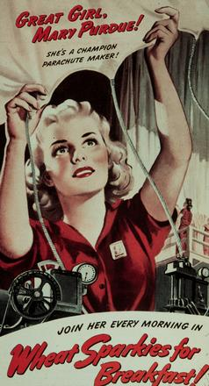
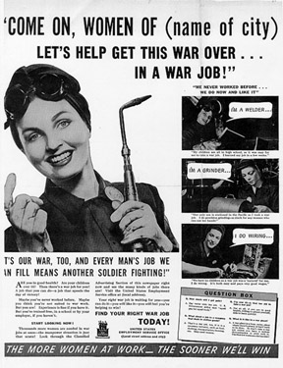
War Work

Slide 6
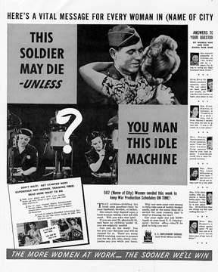
Women’s War Work
Women could support the nation and their men by going to work in industry.

Slide 7
World War II
Ads compared industrial machinery to household appliances. The OWI encouraged the design of special fashions so ‘vain’ women could look glamorous while working.
Literature and posters stressed worked as a patriotic duty – “The More Women at Work, The Sooner We’ll Win;” “Longing Won’t Bring Him Home, Get A War Job.”
The War Manpower Commission (WMC) and the Office of War Information (OWI) faced a huge challenge in mobilizing women workers.
Created in 1942, the WMC launched three public message campaigns to attract women into the workforce.

Slide 8

World War II
Wartime propaganda directed at women had two major effects –
  It created an image of women as dynamic citizens
  It helped to persuade millions of women to go to work
  Between 1940 and 1945, female workers increased by slightly more than 50 percent.

Slide 9
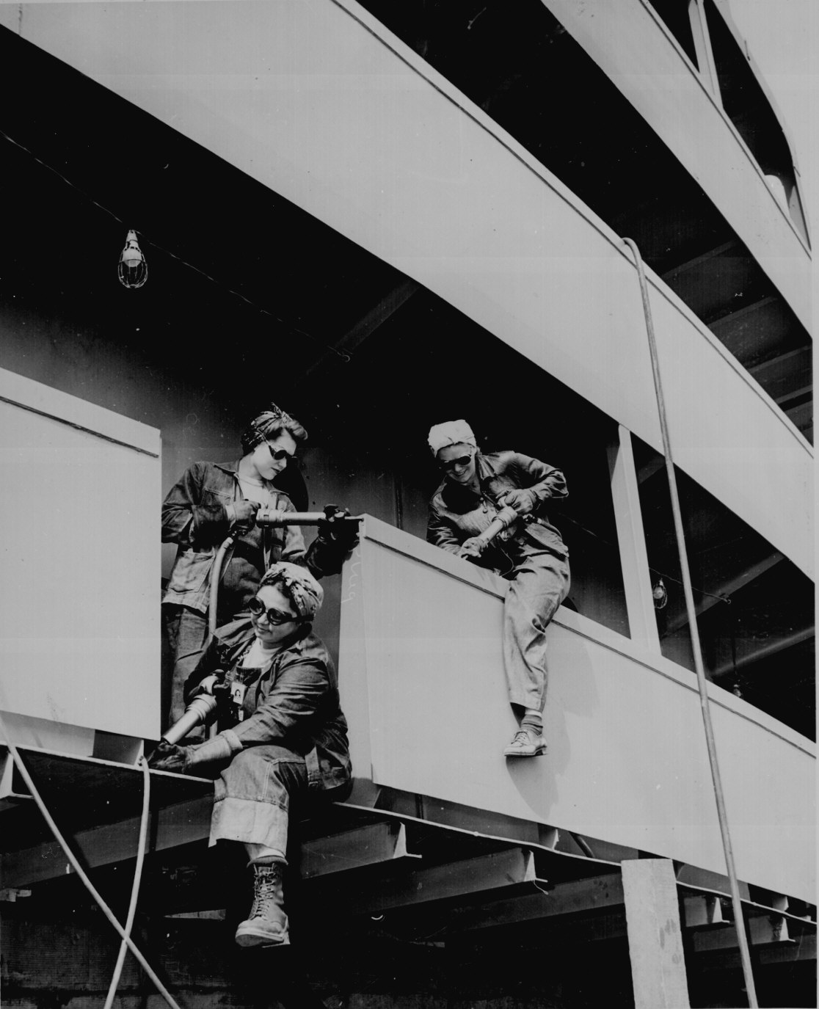
World War II
In 1940, 11,970,000 women worked outside the home
In 1945, 18,610,000 did so
This meant that the proportion of women working for wages, three-fourths of whom were married, rose from 17.6 percent to 37 percent in this period.

Slide 10
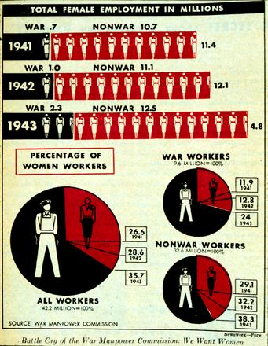
World War II
Women with small children also took wartime jobs. In 1942, the Lanham Act established Child Care Centers in 41 states.
  The government intended these centers only as emergency wartime measures rather than a sign of women’s acceptance into the labor force. After the war, the centers were closed.

Slide 11
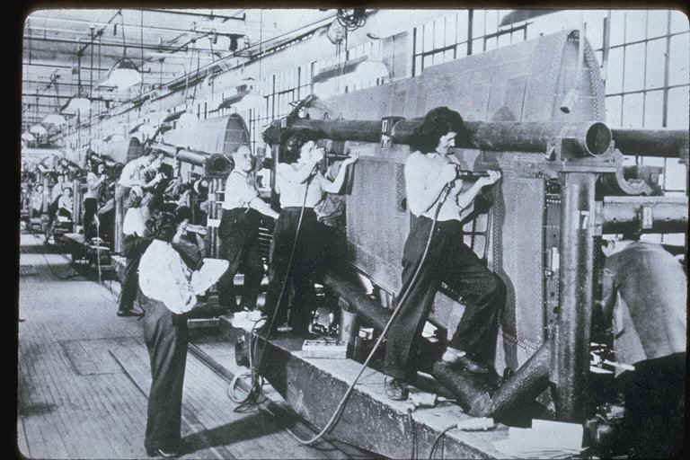
World War II
During the war, women replaced male workers in ordnance plants, shipyards, aircraft factories, and steel mills.
The also got new opportunities as musicians, scientists, doctors, attorneys, university professors, government officials, athletes, and teachers.
Aircraft builders

Slide 12
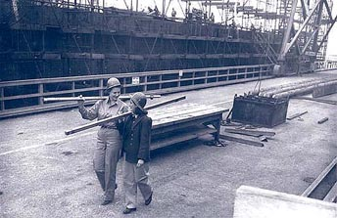
World War II
The federal government hired a huge number of women. In 1939, less than 200,000 women worked in civil service jobs; in 1940 they totaled more than one million – 540 percent increase.
In 1942, the National War Labor Board ordered equal wages for women who performed “work of the same quality and quantity” a male laborers.
Women, however, suffered pay inequity because of lack of enforcement.
Ship builders

Slide 13
World War II
Wartime gains for women included
  end of age requirements for teachers and
  bans against hiring married women teachers
Approximately, half of black domestic servants found jobs with higher pay and more status.
Other women of color and disabled women also obtained employment in factories.
By the end of the war, between 3 to 3.5 million women, including women of color, belonged to unions.
Women still faced
  prejudice from male workers,
  restricted membership, and
  exclusion from positions of leadership.
World War II opened jobs long closed to black women.\
  Approximately, 600,000 entered the labor force between 1941 and 1945.

Slide 14
World War II
Aided by the
  Fair Employment Practices Commission (1941),
  the National Council of Negro Women, and
  the NAACP,
  the number of black factory operatives more than doubled; increasing between 1940 and 1944 from 6.8 to 18 percent.
Black clerical, sales and professional workers also increased substantially by 1945,
  while the percentage of black women in domestic service fell from 59.9 to 44.6 percent.
Black women continued
  to earn lower wages than white women and
  remained in segregated in heavy, dirty, and hazardous jobs
  with lower pay
In Detroit and St. Louis defense factories, black women worked in segregated plants and workshops
In the federal civil service, they not only labored in separate offices but were denied opportunities for advancement.

Slide 15
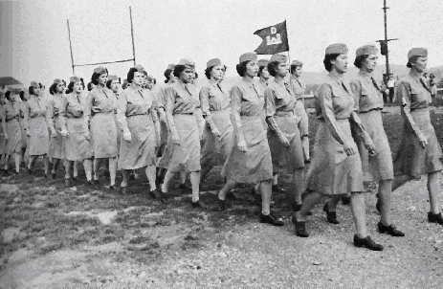
World War II
A large group of women decided to join the armed forces
Women continued to serve as nurses
After Pearl Harbor, they participated in non-nurse corps for the first time
The U.S. Army organized the Women’s Army Auxiliary Corps (WAAC) in May 1942.
  It granted women only partial military status and no benefits.

Slide 16
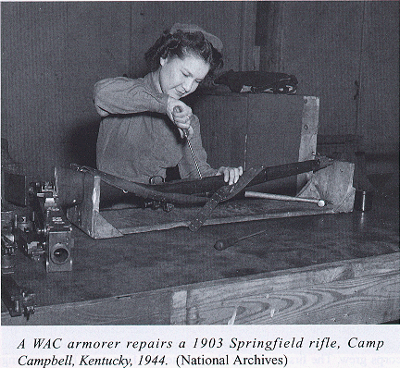
World War II
The military called on black women
  continued to believe that they were best employed in cooking, cleaning, and other maintenance work.
Black women staged sit-down strikes and filed complaints asking for more than menial duties.

Slide 17
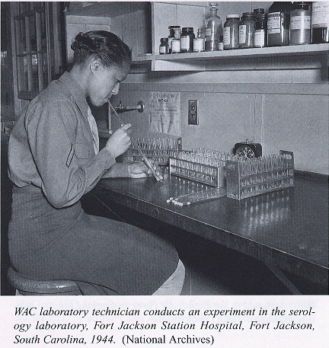

Slide 18
World War II
The pressure of the black press, civil rights groups, and black women’s organizations
  the war department finally agreed that black women should account for 10% of total WAAC female officer candidates
These women, forty of them, virtually all college graduates, were among 440 women who comprised the first class of WAAC officer candidates.
Sexism, predictions of failure, stories of sexual liaisons with military men, and rumors of lesbianism plagued both white and black WAAC units.
In July 1943, the WAAC became the Women’s Army Corps (WAC) and offered women recruits the additional enticements of the same rank, title and pay as male reservists.

Slide 19
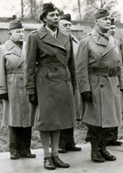
World War II
The WAC distinguished itself by commissioning the first African American woman officer, Charity Adams Earley, who lead 39 black women, the first all-black female unit to serve overseas.
The WAC required black officers to live separately and lead only segregated WAC companies.

Slide 20
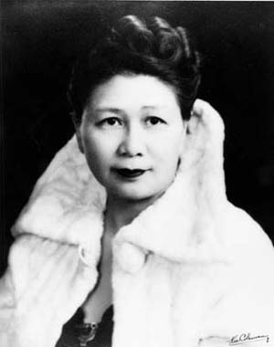
World War II
By mid-1942 due to the lobbying of Dr. Margaret Chung, the first Chinese American women physician, the Navy created the Women Accepted for Volunteer Emergency Service (WAVES)
Established in July 1942, the WAVES immediately offered pay and benefits comparable to male reservists.

Slide 21
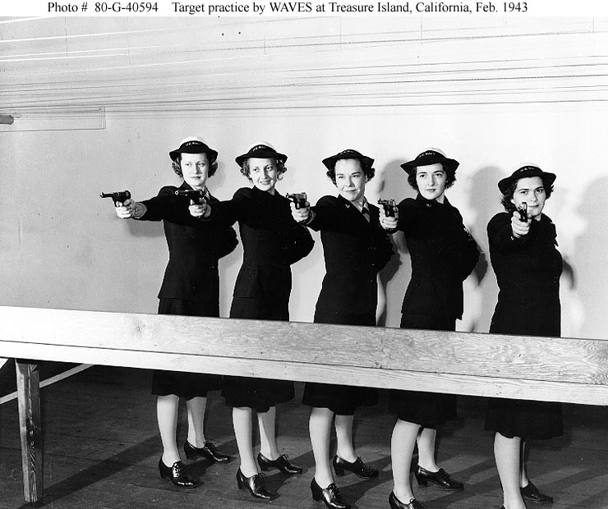
World War II
One-third of the women trained pilots, packed parachutes, and operated weather stations.
WAVES excluded black women until 1944 when President Roosevelt ordered their admission but it was so late in the war that less than 100 black WAVES actually served.

Slide 22
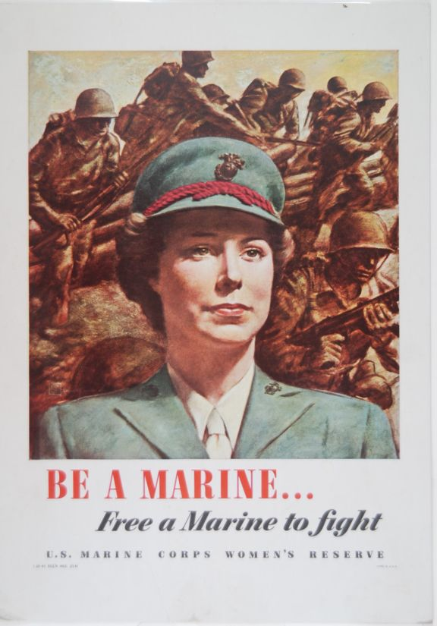
World War II
Marines were the last military branch to establish a woman’s corps. Women provided one-third to one-half of post troops, mechanics and aviation personnel. At Cherry Point, NC the flight instructors were all female. Women marines also packed parachutes and ran the control power.

Slide 23
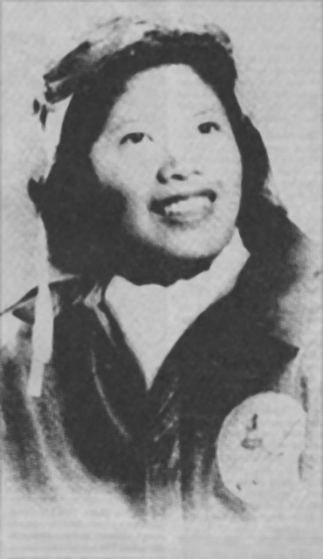
World War II
350,000 women served in the U.S. armed forces
  every military activity except combat
Early in 1945, the efforts of black activists and civil rights proponents led to the end of segregated assignments
Asian American women distinguished themselves in the service
  Pilot Maggie Gee served with the Women’s Air Force Service Pilots Program transporting military aircraft in the U.S.

Slide 24
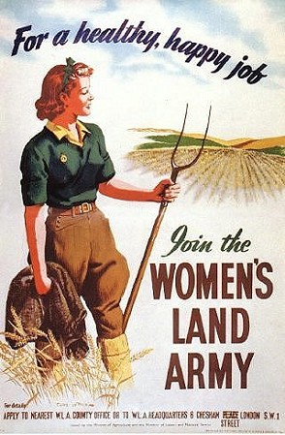
World War II
Nearly two-thirds of the adult female population did not hold employment outside their homes or service in the military. They worked on behalf of the war through their own communities –
  Women in Chinese communities formed chapters of the New Life Movement to organize women for war relief efforts

Slide 25
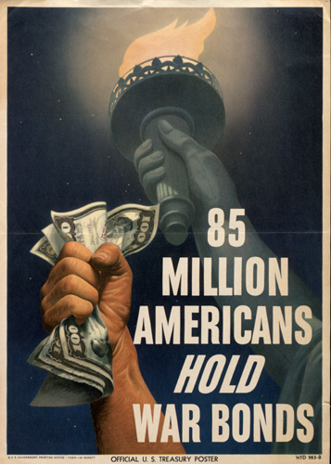
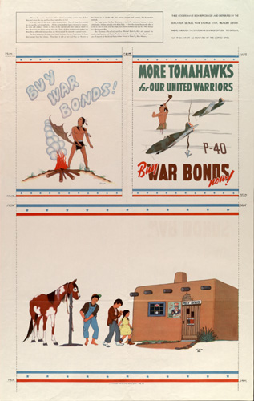


Slide 26
World War II
  Millions of women gave their time and energy to the Red Cross and the Office of Civil Defense –
    Providing entertainment for military men and women at USO canteens
    Sold war bonds, raised victory gardens, canned foods, collected tin cans and newspapers for recycling, and stretched their families food and gasoline rationing stamps
  War brides provided an unrecognized support system for the armed forces
    Between 1940 and 1943, one million more marriages occurred than predicted
    Four to five million women married service men
    As brides, the women traveled all over the country to live on or near bases; there they joined the Red Cross, volunteered as motor pool drivers, worked in hospitals and United

Slide 27
World War II
  Service Organization (USO) and a number of other services
During the 1940s, women’s basic nature was questioned – were women really “natural” mothers who were happiest and most fulfilled surrounded by children?
The average number of children dropped to two to three children per women.
Women had a more limited, sanitized view of pregnancy and childbirth. They shopped for the latest birth control technology and advisors
In 1942, the American Birth Control League transformed itself into the Planned Parenthood Federation of America.
Preferred planned parenthood over birth control because officers felt it had a greater public appeal.

Slide 28
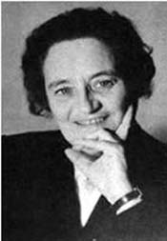
World War II
Most states tightened regulations surrounding birth, excluding midwives. Women themselves seemed to prefer “physician-managed” childbirth
During the war years, Freudian psychologist, Helene Deutch argued that women’s dependency grew out of their learned dependence on their mothers.
She explained that women had repressed rage which put them in danger of developing neuroses. Deutch published the tow volume, Psychology of Women in 1944.

Slide 29
World War II
By the end of the war in 1945, American women had experienced many modifications in their images, roles and lifestyles.
In 1945, the Women’s Bureau reported that a significant number of women workers hoped to keep their jobs after the war.
Eighty percent of working women wanted to continue working. (Included 57% single; 34% married; 15% widowed or divorced)
A study of women workers in Michigan defense plants, however, revealed that a significant number of women had no desire to change their lives and saw their war work not as opportunity for emancipation but as a temporary emergency.

Slide 30
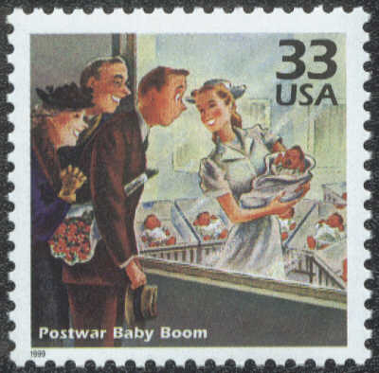
World War II
U.S. government agencies reversed Rosie’s image – showed Rosie abandoning her welding torch and retreating to the suburbs.
The media cooperated by encouraging women to marry and bear children, to create warm home lives and to act sweet, supportive and motherly to their returning veterans.
In early 1946, a New York Times reporter commented that “the courtship of women workers has ended.”

Slide 31
In-Class Discussion
Develop a list of significant government policies regarding women and gainful employment following World War II. How did these policies affect women’s lives?

