Slide 1
Women in America
Lecture 7
Reordering Woman’s Sphere: Progressivism, 1890-1914
1

Slide 2

The Progressive Era
With the founding of the Populist Party in 1890 and the Panic of 1893, discontent began to spread across America
The word “reform” was again shouted across the land. People called for transformation of the American landscape in business, industry, education, government, race relations, the family and women’s roles
2

Slide 3

The Progressive Era
Americans exchanged their fascination with the pursuit of wealth and the creation of gigantic corporations for a concern for consumers’ rights and trust-busting.
Young, educated, middle to upper class women and men formed the vanguard of the Progressive movement of the 1890s and early 1900s.
3

Slide 4
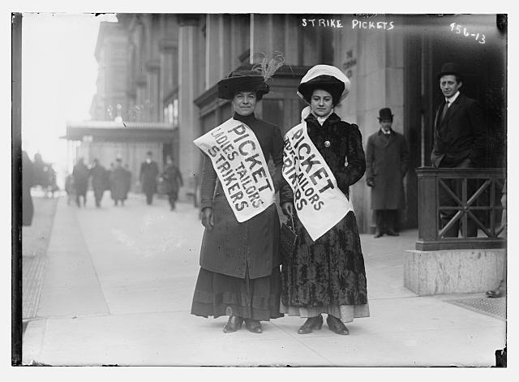
The Progressive Era
Reformers’ age, ethnicity, gender, race, religion, and social class affected their thinking concerning reform. Thus people held very different beliefs regarding which reforms should take priority.
Many middle and upper class women worked reform through their long established women’s clubs
4

Slide 5
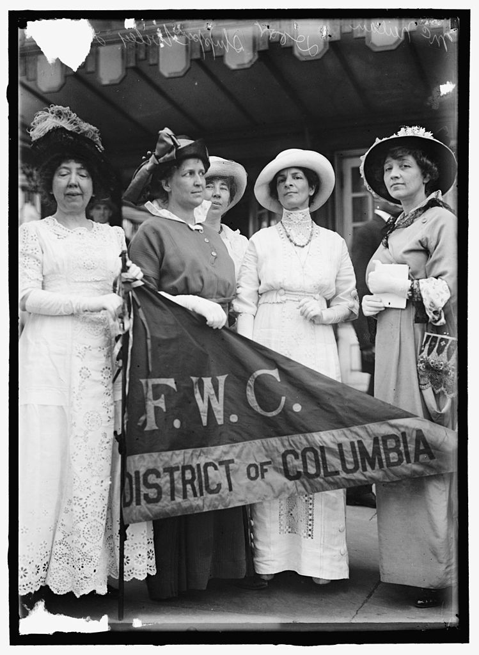
The Progressive Era
By 1890, the women’s club movement had grown to such proportions that individual clubs joined into a national association called the General Federation of Women’s Clubs (GFWC) which encompassed 200 clubs and 20,000 women
Women’s clubs focused on cultural and literary activities, improving social conditions within their own communities, opening new jobs and careers for women and achieving women suffrage.
5

Slide 6
The Progressive Era
The club members devoted their time to “municipal housekeeping” meaning that women had special talents and moral responsibilities which allowed them to understand and solve civic problems.
The philosophy of the women’s club movement has been called “domestic feminism,” an enlargement of women’s interests and sphere through reform activities.
By providing a basis for women’s organized volunteerism and legitimizing women’s participation in civic affairs, the club movement helped women enter the public arena so long dominated by men.
Although clubwomen did not demand equality, they made it clear that women’s proper place was no longer restricted to the home.
6

Slide 7
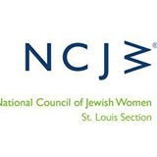
The Progressive Movement
Although the club movement was mainly middle-upper class women, it went beyond native-born Protestant women
The National Council of Jewish Women (1893)
1902 kosher meats strike by Jewish homemakers
Jewish women’s groups connected with the Zionist movement
7

Slide 8
The Progressive Movement
Immigrant women workers campaigned and organized themselves
  Immigrant Protection League of Chicago
  Polish Women’s Alliance 1898
  Finnish Women’s Cooperative Home 1910
  The club movement did not encompass all women –
  it did not address the issue of racial discrimination
  The GFWC did not recruit black members
  When they did admitted black clubs, it was on a segregated basis
  Black women developed a separate club movement; still dominated by middle and upper class women
  black club women had different priorities
  their focus was on improving the lives of black people
8

Slide 9
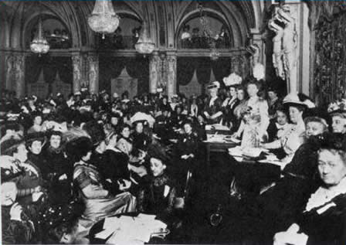
The Progressive Movement
Black clubs supported suffrage as a method to further social reform.
The effect of club women’s activities on the customary view of American women proved somewhat limited. Women reformers and club women continued to emphasized their womanly virtue.
Because of this they segregated their efforts and continued to see men as objects of reform rather than partners in reform endeavors.
9

Slide 10
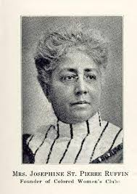
The Progressive Movement
Josephine St. Pierre Ruffin founded the Boston Women’s Era Club. It’s monthly magazine had articles on fashion, health and family life.
She helped found the National Federation of Afro-American Women in 1895, after white journalist James W. Jack vilified black women as “prostitutes, thieves, and liars.”
Her call to “Let Us Confer Together” drew 104 black women to a meeting in Boston.
10

Slide 11
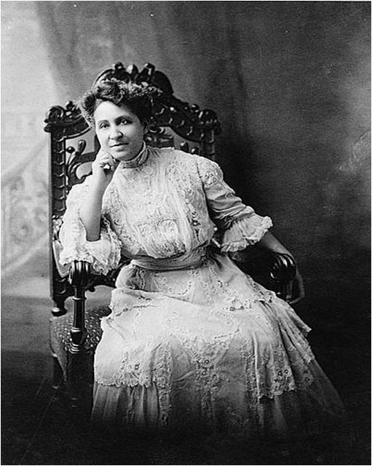
The Progressive Movement
A rival association, the Colored Women’s League in Washington, D.C., was headed by Mary Church Terrell.
In 1896, the National Federation of Afro-American Women and the National Colored Women’s League merged to form the National Association of Colored Women (NACW) with Church Terrell elected as first president.
The NACW adopted the self-help motto “Lifting as We Climb” and stressed moral, mental, and material advancement. It had 50,000 members and 1,000 clubs nationwide by 1914.
11

Slide 12
The Progressive Movement
Education played a key role in Progressive women’s reform.
  The number of middle and upper class whites women college students increased
  Women’s colleges dedicated themselves to educating women without destroying their health and femininity
M. Carey Thomas, president of Bryn Mawr, took the lead in challenging concepts of domesticity. She was the first woman to earn a Ph.D., and believed that women had the capability to do serious scholarship. She didn’t believe that women should sacrifice careers for “suffocating” marriage.
12

Slide 13
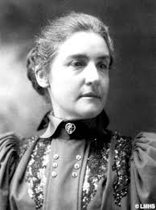
The Progressive Movement
Thomas did not marry but had a long term relationship with a female partner - called at the time a “Boston marriage.”
Coeducational schools saw the percentage of their female students rise by 50%; so they had to figure ways to attract male students.
  Relegated women to teaching and home economics department
13

Slide 14
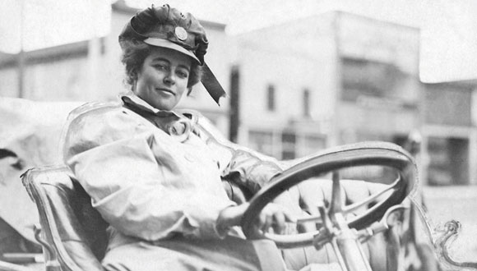
The Progressive Movement
  At large research schools, women began enrolling in the social sciences and pioneering research in gender differences
  Colleges and universities offered athletic opportunities to women; first in tennis; then basketball.
  By the mid 1890s women were involved in numerous athletic competitions
  With the coming of the automobiles, Joan Newton Cuens was an auto racing champion (1905-1909); Alice H. Ramsey was the first women to drive across the U.S.
14

Slide 15
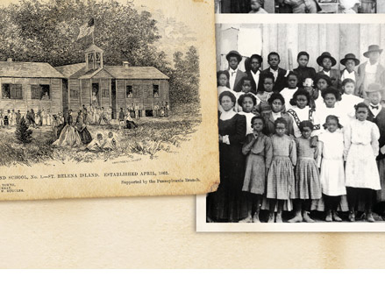
The Progressive Movement
After 1890 a growing number of black women received advanced training as teachers. The number of black women teachers outnumbered black males almost 2 to 1; by 1910 the number was 3 to 1 – of 29,772 black teachers, 22,547 were female.
15

Slide 16
The Progressive Movement
Racial issues
  Focused on difficulties facing black Americans
  Began to investigate American Indian problems
  Latinos and Asians were overlooked
  In 1892, Ida Wells-Barnett organized a national anti-lynching crusade
  Black women addressed a number of other race related problems --
  Tuberculosis
  Prostitution
  Urban migrants (housing, employment, training)
  Urban Problems –
  By 1890s, urbanization and massive immigration had created cities rife with tenements, crime, disease, and despair
  By 1900, 6 American cities numbered over a half million people; three of them with over one million people
16

Slide 17
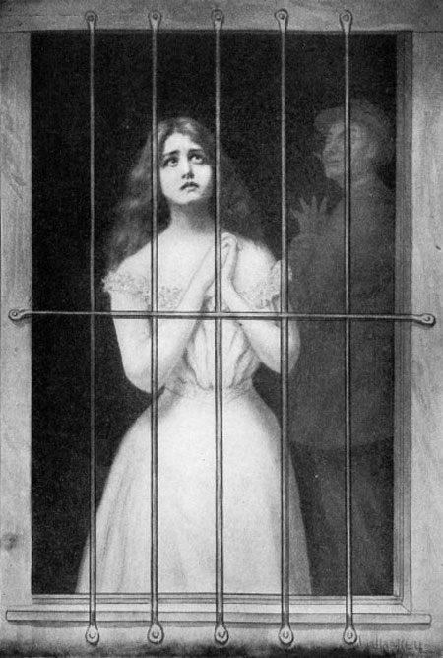
The Progressive Movement
Reformers addressed prostitution as a “Social Purity” crusade; a “social evil” that constituted a moral problem and a national menace.
Congress passed the White Slave Traffic Act/Mann Act in 1910; didn’t stop prostitution; it moved from brothels to the streets and pimps and crime syndicates took over the organizing.
17

Slide 18
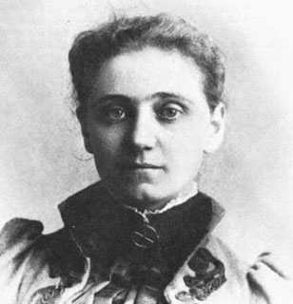
The Progressive Movement
Jane Addams embarked on her career in settlement houses. She and her friend Ellen Gates Starr established Hull House in Chicago in 1889.
Settlement houses offered a number of programs including vocational training, childcare and kindergarten, youth clubs, immigration reform, and health education and care.
Settlement house leaders attacked slum conditions by campaigning for better garbage collection, public health programs, and the establishment of branch libraries and museums
18

Slide 19
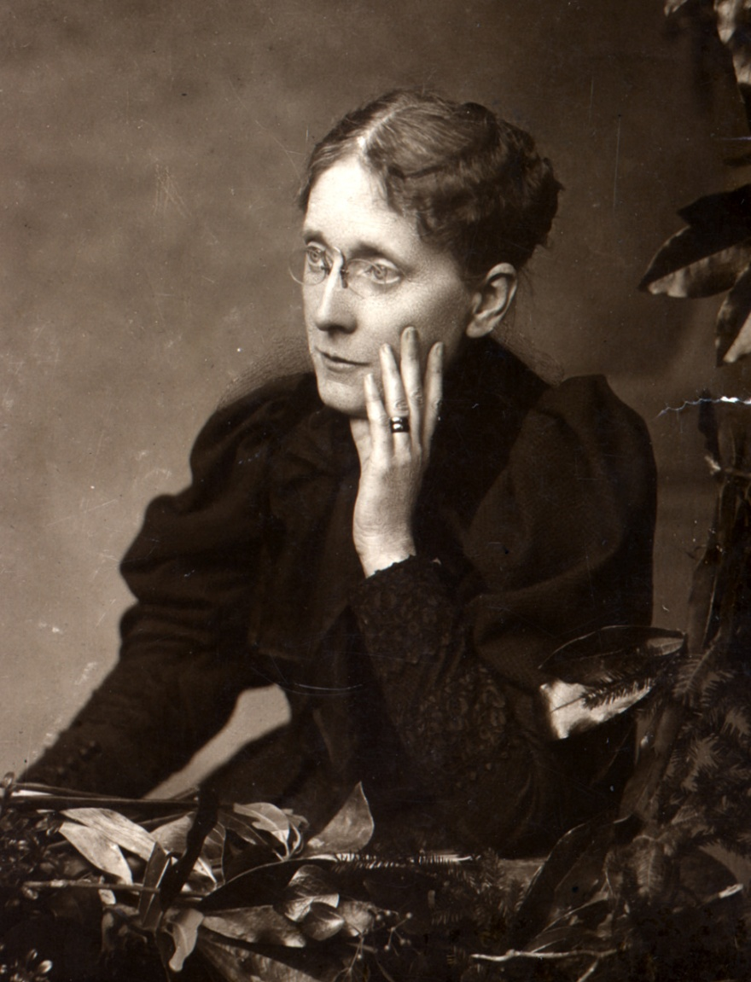
The Progressive Movement
They also crusaded for labor reformers such as the 8-hour day, minimum wage and unionization; also advocated welfare programs, unemployment compensation, and early social security
The campaign against alcohol continued. The Women’s Christian Temperance Union (WCTU) became the largest women’s organization. Frances Willard the driving force behind the Union’s success.
19

Slide 20
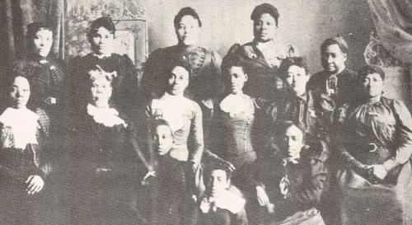
The Progressive Movement
WCTU owned newspapers, office buildings, temperance hotels, and other related businesses
  It provided a practical training ground for female leaders, business executives, speakers, and writers
  Also added women’s suffrage to its program
  At right – Frances Ellen Harper branch of WCTU
20

Slide 21
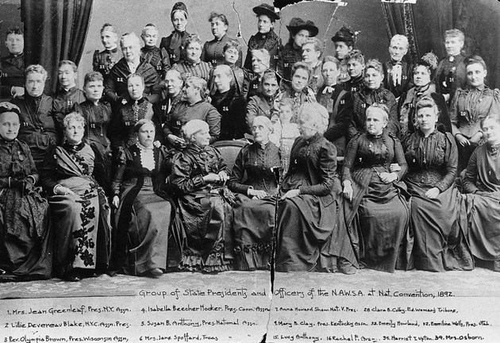
The Progressive Movement
In 1890 the National Woman Suffrage Association and the American Women Suffrage Association united into the National American Woman’s Suffrage Association (NAWSA) – Elizabeth Cady Stanton, first president; Susan B. Anthony replaced her in 1892
21

Slide 22
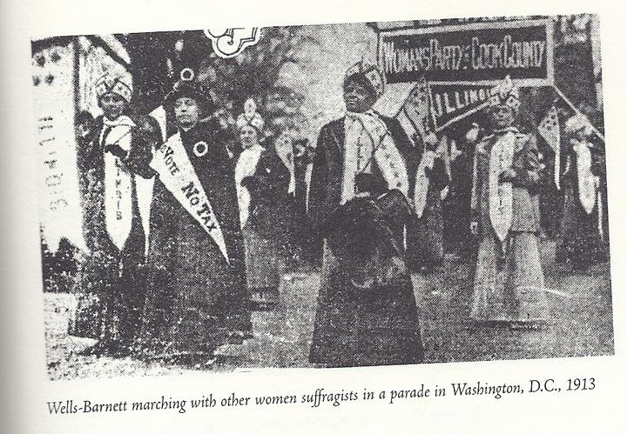
The Progressive Movement
Between 1904-1915, the NAWSA tried to stay out of controversy so they were less militant, paid attention to education campaigns and state suffrage campaign
Supported white supremacy and stayed away from recruiting black women as members
Black women formed their own suffrage associations arguing they needed the vote for themselves as female citizens and to enhance their efforts to uplift and liberate black people.
22

Slide 23
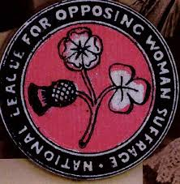
The Progressive Movement
In 1911 an anti-suffrage group, National Association Opposed to the Further Extension of Suffrage to Women organized.
23

Slide 24
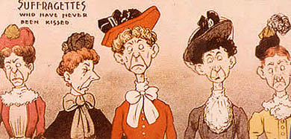
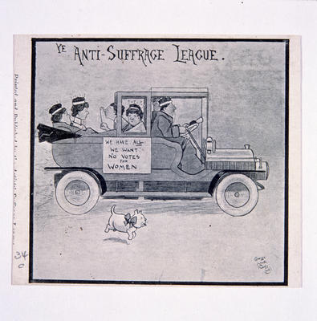
The Progressive Movement
24

Slide 25
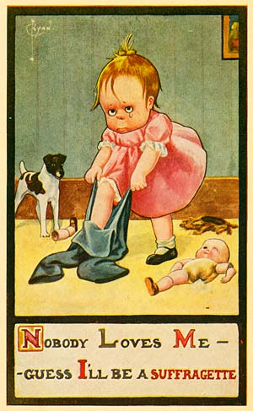
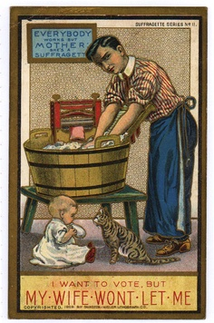
The Progressive Movement
25

Slide 26
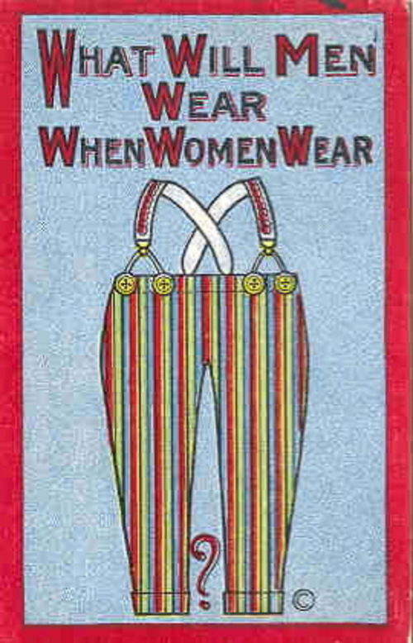
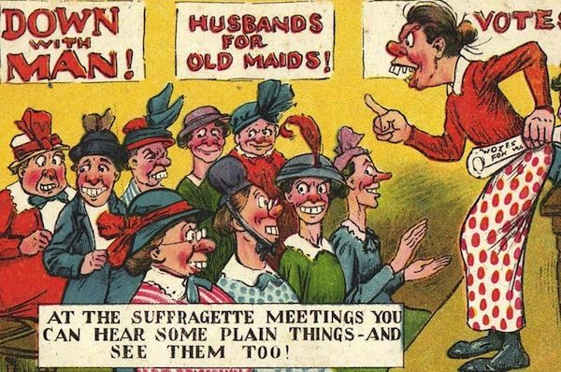
The Progressive Movement
26

Slide 27
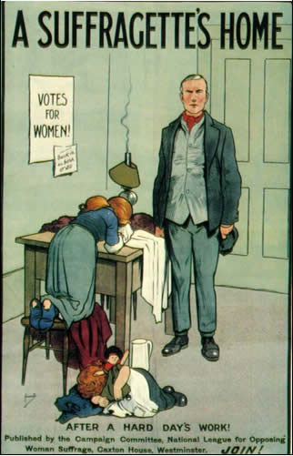
The Progressive Movement
27

Slide 28
In-Class Discussion
Identify several settlement houses and the women who organized them and discuss whether all settlement houses operated the same way. What were the settlement house volunteer’s motivations? Consider the settlement house experience from the immigrants’ perspective.
28

