Slide 1
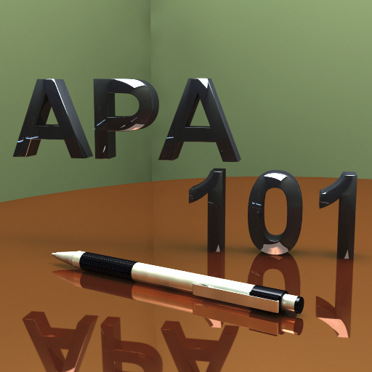
APA Style: A Primer
CASS, Fall 2015

Slide 2
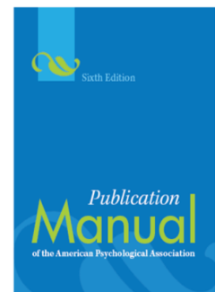
No magic wanD
Not surprisingly, CASS tutors receive a lot of questions about how to create references for all sorts of different sources in APA format.
We don’t have a magic wand to generate perfect citations for you!
Instead, we work with you to create citations from sources like the Publication Manual, which we keep on reserve in our tutoring library!

Slide 3
Purdue owl is free & Helpful
Find Publication Manual rules online!

Slide 4
APA origins

Slide 5
Apa is different from mla/chicago

Slide 6
APA Papers utilize sections

Slide 7
APA Format

Slide 8
A few formatting rules

Slide 9
Running head

Slide 10
Running head

Slide 11
Running head

Slide 12
Running head
Did you know that if you type Crtl + End, Microsoft Word will insert a page break automatically?

Slide 13
Running head

Slide 14
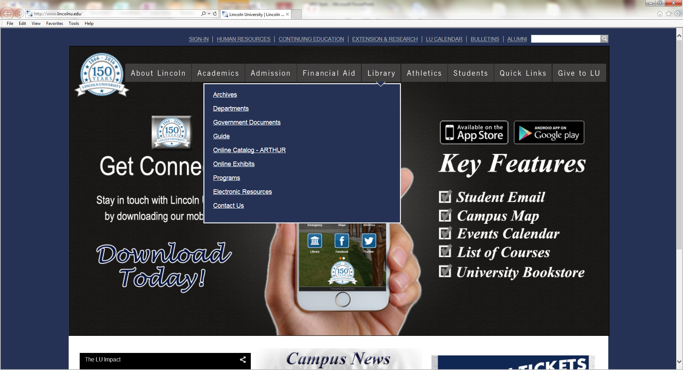
With apa papers comes research
You can use library resources to find books and journal articles to cite in your papers.
We recommend using the Electronic Resources tool!

Slide 15
Ebscohost
Free research database @ LU!!!

Slide 16
Search your paper topic to find articles!

Slide 17
Ebscohost even has a citation tool!
Warning, while the citation tool is helpful, it is not 100% accurate.
You still have to follow the APA citation rules and make corrections.
Clicking the Cite tool auto-generates a citation of the article you are reading online.

Slide 18
References are key in apa

Slide 19
In text samples

Slide 20
References vary by # of authors

Slide 21
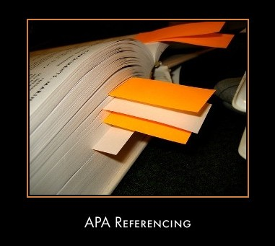
Works cited at end of paper

Slide 22
Sample reference

Slide 23
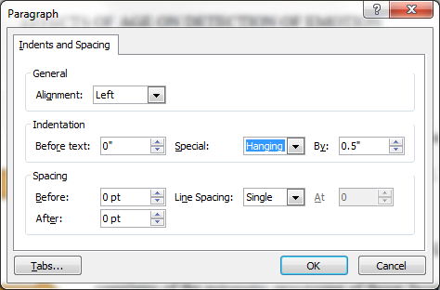
Hanging indent

Slide 24
Electronic documents
Example:
Author, A. (year). Title of article. Journal Title,
X, xxx–xxx. doi:xxxxxx

Slide 25
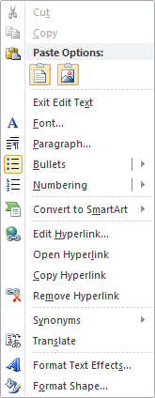
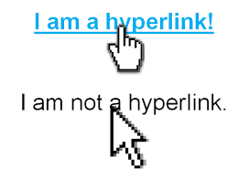
Website citation
If there is no DOI and you must type the web address, you can remove the hyperlink to the website.
It’s easy – right click and pick Remove Hyperlink!
If your paper is being submitted electronically, you may want to leave hyperlinks in the paper. See what your professor wants.

Slide 26
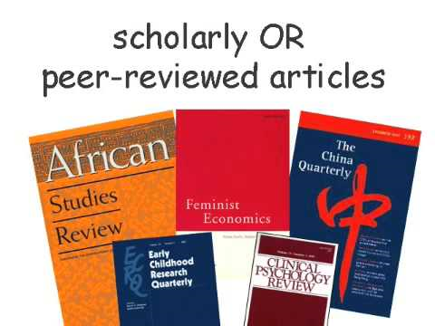
Common reference types

Slide 27
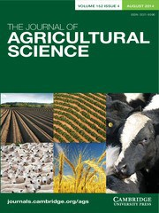
Journal article citation

Slide 28
Book chapter citation

Slide 29
Whole book citation

Slide 30
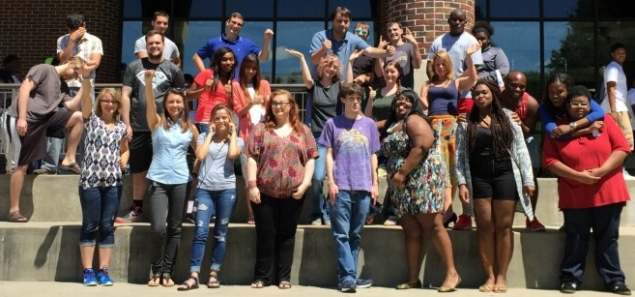
Information for this PPT from:
http://www.apastyle.org/
LU Tutors & SI Leaders –
Here to Help You Master APA Style!
You got this!
Free tutoring – Lower Level, Page Library

