Slide 1
Writing 101 for Nursing Students
LU Academic Support
Amy Miller
Fall 2017

Slide 2
Writing assignments do not have to be painful. It’s all about communicating what you know and think.

Slide 3
Where to begin?
Begin by reviewing your assignment carefully to determine the required format, the purpose of the project, as well as the kinds of research needed for the particular task at hand.
If you don’t understand the assignment, what can you do?

Slide 4
You are not in this alone.
If you don’t understand the assignment, visit with:
Tutors (Lower Level, Page Library)
Peers
Professors
Librarians
Mentors

Slide 5
Top 5 Tips for Getting Writing Tutoring
Plan ahead! Start when a project is assigned and make multiple visits. Writing is a process that takes time. You may need follow-up visits.
The center does not give appointments for tutoring. Schedules are posted on Canvas “All_Students” page.
Try to plan at least 30 minutes with your tutor, but no more than 50 minutes.
Bring your assignment sheets from class!
Don’t expect a magic citation wand! Tutors are superb guides for showing you how to organize your research and citations, but it takes time to properly cite sources.

Slide 6
Once you understand the assignment…Pre-write!
Define your topic and keywords through pre-writing, a strategy used to begin brainstorming ideas before a project begins.

Slide 7
Once you understand the assignment…Pre-write!
Seriously.

Slide 8
Pre-writing Strategies
FREE WRITE for 5 minutes about your assignment topic without stopping to reflect on what you have written.
Write anything that comes to mind, and don’t worry about correct grammar, or complete sentences.
If you have read other texts to which you must respond, write your thoughts or recollection of each one.

Slide 9
Pre-writing Strategies
LIST of all your different thoughts in response to the assignment.
Try to generate as many different ideas, details, pieces of evidence or possible approaches to the problem as possible.
The goal is to list all the information and ideas you have on the topic.
Do not try to put things in order; just get all the different thoughts in your head out on paper.

Slide 10
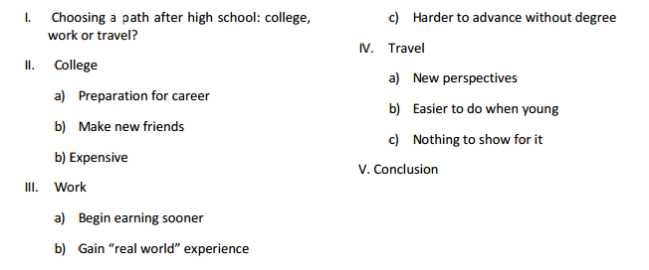
Pre-writing Strategies
Make an OUTLINE to sort main ideas from supporting details:

Slide 11
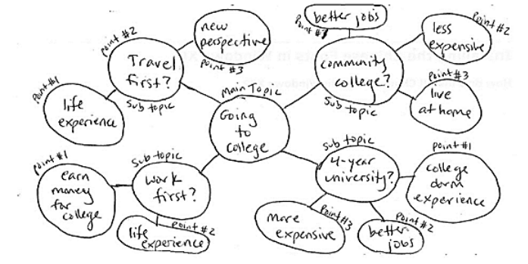
Pre-writing Strategies
Use a CLUSTERING diagram. It might look like this:

Slide 12
After Pre-writing, begin a Thesis Statement…
A thesis statement, or purpose statement, is the organizing claim your essay or project makes.
Every piece of writing you produce for your classes should state a clear purpose or thesis.
You can change your thesis as you write, but forcing yourself to write a thesis in the beginning adds direction to your writing.

Slide 13
Which is a better thesis Statement?

Slide 14
Move from your thesis statement to your supporting subtopics…

Slide 15
Every paper needs a thesis, and every supporting paragraph needs a topic sentence…

Slide 16
Why?
If you don’t know where you are going, how is anyone else going to follow you?
Your thesis and you topic sentences are how you communicate where you are going.

Slide 17
Keys to good topic sentences…
Stick to a single point. Sometimes ideas should be developed into multiple paragraphs.
Is the topic sentence relevant to or supporting the main thesis? If not, reconsider how you might make it relevant or edit it out.

Slide 18
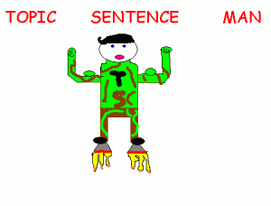
More keys to good topic sentences…
Is there a clear relationship between this topic sentence and the paragraph that came before? Using the proper transitional phrase is important for flow.
Does the topic sentence organize and control the paragraph? If a paragraph seems to unravel, look at each sentence and see if it's relevant to the claim made in the topic sentence. If not, the paragraph (or the topic sentence) should be revised.

Slide 19
Make sure to deliver on the promises made in your topic sentences…
Generally you will want to see 3-4 supporting sentences in a paragraph.
If you don’t have 3-4 sentences, offer more supporting evidence.
Don’t just make a list; develop details about items you list.
Double check the relevance of each sentence is clear.
Don’t offer the same evidence over and over again.

Slide 20
Using good closure!
A concluding sentence indicates that you are bringing closure to a paragraph or essay. Many writers fail to close out the final thoughts about the topic on which they are writing and leave the audience hanging.
Use a concluding sentence starter to signal the end:
In conclusion
Therefore
As expressed
Overall
As a result
Thus
Finally
Lastly
For this reason
In general

Slide 21
Using good closure!
Some other characteristics of an effective conclusion include:
Sentence reviews main points mentioned in a paragraph
Sentence restates the topic sentence in a new way
Sentence avoids introducing new ideas or unrelated topics.

Slide 22
Checking Your Work
Re-read just the thesis and topic sentences of your paper. Do they string together coherently to support the point you want to make?
When you put the thesis and all of the topic sentences together, they should read more or less like a coherent paragraph.
If they don't, then something is wrong with the structure of the paper.
Go back to your outline and see what went wrong!

Slide 23
Conduct research to fill in information about your topics.
You can’t write about what you don’t know.
Reviewing other articles about your topic may help you formulate you thoughts, but don’t steal other people’s work.
Keep track of your research and cite as needed.

Slide 24
Keeping track of your research avoids plagiarism.
Color codes
Post-its
Highlighting quotes and main ideas (not ALL the ideas!)
You can highlight on a computer, too!

Slide 25
Where to Look for Research?

Slide 26
Use your research to support your thesis…
Don’t just throw random quotes in your research paper!
You need to finesse them in with a quote sandwich!

Slide 28
Quote Sandwich Example
Professor Jim Miller argues that a military draft can improve our society by improving the character of the young people who serve in it. He claims that “we should serve our country while we are young, so we can learn from military experiences and carry those experiences into college or careers.” (Miller, p. 21). I agree with Miller that requiring everyone to serve could cause much personal growth and development of the youth in our country, plus help men and women to have more success in college and life.

Slide 29
Don’t forget to re-read and revise!

Slide 30
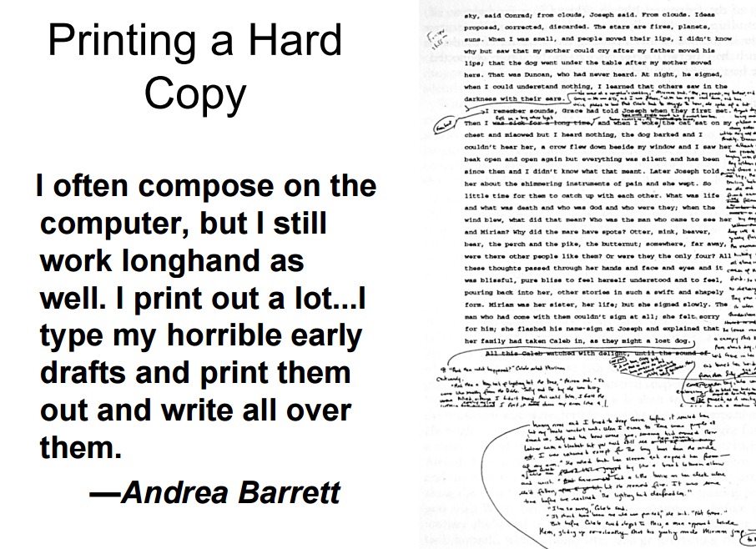
Seriously, don’t forget to revise! You’ll catch more if you print.

Slide 31
You’ll catch even more if you read out loud.

Slide 32
Do your professors really expect you to put that much effort is a writing assignment? Yes. Yes, they do. Every single time.

